Slide 1
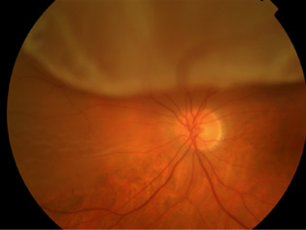
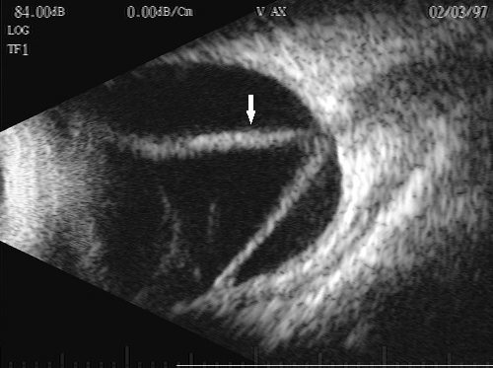
50 YEAR OLD
MALE
MYOPIC
SUDDEN PAINLESS LOSS OF VISION
NO H/O TRAUMA

Slide 2
RETINAL DETACHMENT
Dr. K. Kanthamani
Prof. and HOD
SDUMC

Slide 3
CAUSES OF SUDDEN PAINLESS LOSS OF VISION ?

Slide 4
OBJECTIVES
Definition
Classification
Etiology
Pathogenesis
Complications
Treatment

Slide 5
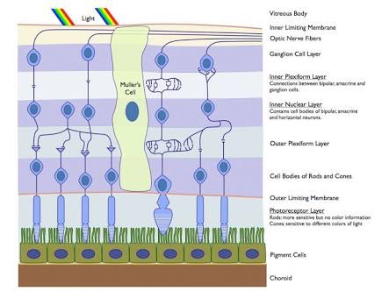
INTRODUCTION
Separation of neurosensory retina from pigment epithelium

Slide 6
CLASSIFICATION
Rhegmatogenous / Primary
Tractional
Exudative
SECONDARY

Slide 7
RHEGMATOGENOUS
Through retinal break
Sub retinal fluid sweeps
Sensory retina separated from pigment epi.

Slide 8
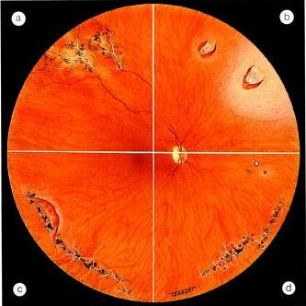
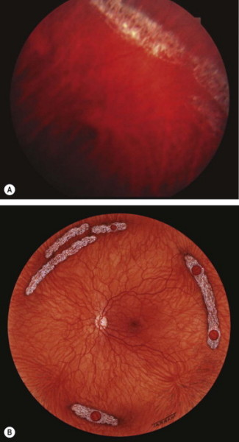
PREDISPOSING FACTORS
Age – M/C in 40 to 60
M:F – 3:2
Myopia
Aphakia
Retinal degenrations
Trauma
Senile PVD
Lattice
Snail track

Slide 9
PATHOGENESIS
Acute PVD
Retinal Degenrations
Aphakia
Retinal Break
Trauma
SRF Sweeps
RETINAL DETACHMENT

Slide 10
CLINICAL FEATURES
Dark spots – vitreous degenration
Photopsia
Sudden , Painless , Vision loss

Slide 11
SIGNS
IOP –Normal / lower
Marcus Gunn Pupil
OTHER CAUSES OF MARCUS GUNN
OPTIC NEURITIS
OPTIC ATROPHY
CRAO
CRVO

Slide 12
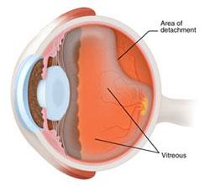
OPHTHALMOSCOPY
Grey reflex
Convex Configuration
Oscillating folds
Funnel Shape – In total detachment

Slide 13
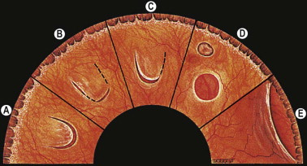
OPHTHALMOSCOPY
Retinal vessels – dark , tortuous cords
Retinal breaks

Slide 14
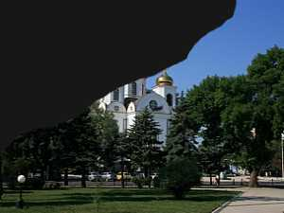
SIGNS
Scotoma
ERG –Subnormal / Absent
Ultrasonography - Confirmation

Slide 15
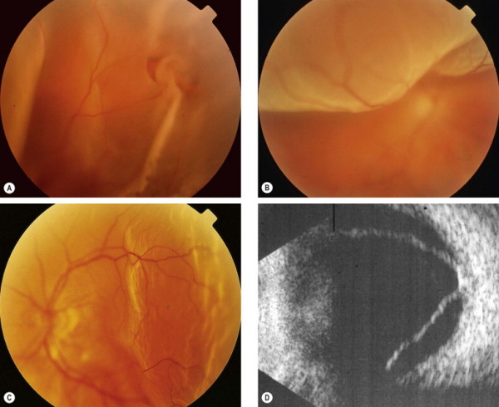
Fresh retinal detachment.
(A) U-tear in detached retina;
(B) superior bullous retinal detachment;
(C) shallow temporal retinal detachment;
(D) B-scan shows a totally detached retina

Slide 16
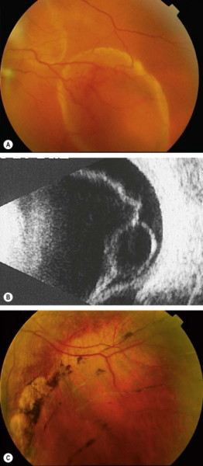
Long-standing retinal detachment.
(A) Secondary retinal cyst;
(B) B-scan shows a retinal cyst;
(C) ‘high water mark’ in an eye with an inferior retinal detachment

Slide 17
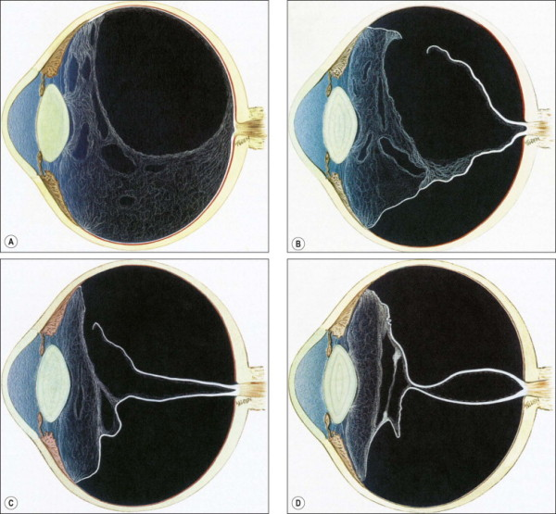
COMPLICATIONS
Proliferative vitreous retinopathy
Complicated cataract
Uveitis
Phthisis Bulbi

Slide 18
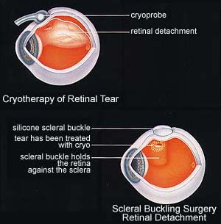
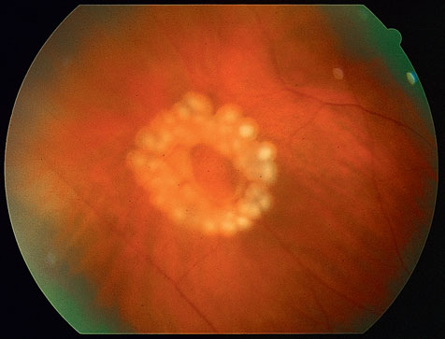
TREATMENT
Sealing of retinal break – Photocoagulation/
cryocoagultion/diathermy

Slide 19
TREATMENT
SRF Drainage
Scleral Buckling
Pneumatic Retinopaxy
Pars Plana Vitrectomy

Slide 20
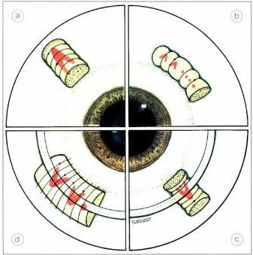
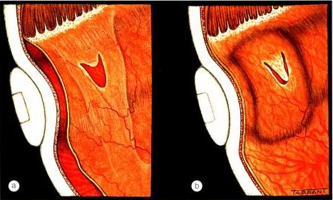
Scleral buckling

Slide 21
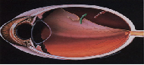
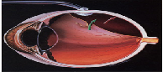
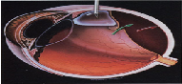
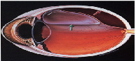
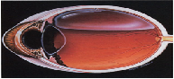
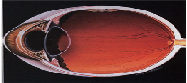
Pneumatic retinopexy

Slide 22
SECONDARY RETINAL DETACHMENT

Slide 23
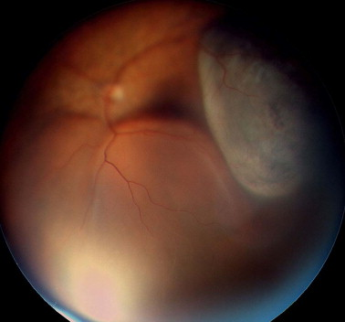
EXUDATIVE / SOLID
Retina pushed – neoplasm / other lesion
CHOROIDAL MELANOMA

Slide 24
ETIOLOGY
Systemic diseases
Toxaemia of pregnancy
Retinal Hypertension
Blood Dyscrasias
Polyarteritis Nodosa

Slide 25
ETIOLOGY
Ocular diseases
Harada’s Disease
Posterior Scleritis
Orbital Cellulitis
CSR
Neoplasms
Sudden Hypotony

Slide 26
CLINICAL FEATURES
No photopsia
No holes/tears
Smooth and convex
Shifting fluid
White solid detachment

Slide 27
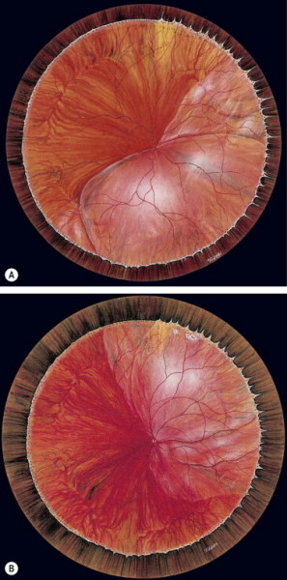
Exudative retinal detachment with shifting fluid.
(A) Inferior collection of subretinal fluid with the patient sitting;
(B) the subretinal fluid shifts upwards when the patient assumes the supine position

Slide 28
TREATMENT
Spontaneous regression
Enucleation – in case of tumors

Slide 29
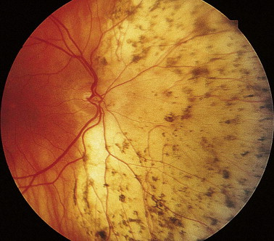
‘Leopard spot’ pigmentation following resolution of exudative retinal detachment

Slide 30
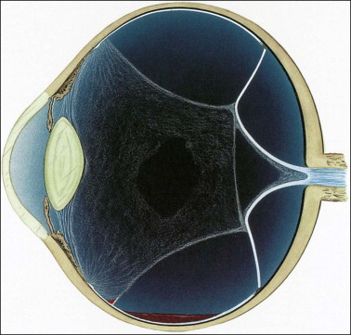
TRACTIONAL
Due to mechanical pull

Slide 31
ETIOLOGY
Post tauma scar tissue
PDR
Post Haemorrhagic retinitis proliferans
ROP
Sickle cell retinopathy
Eale’s Disease

Slide 32
CLINICAL FEATURES
Vitreoretinal bands
Retinal Breaks
No Shifting Fluid

Slide 33
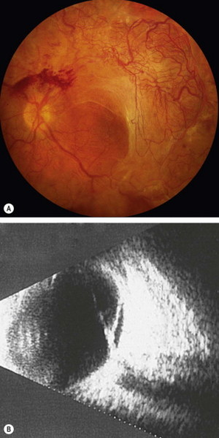
(A) Tractional retinal detachment in severe proliferative diabetic retinopathy;
(B) B-scan image of another patient shows incomplete posterior vitreous detachment and a shallow tractional retinal detachment

Slide 34
TREATMENT
Pars Plana vitrectomy
Cut Vitreoretinal tractional Bands
Internal tamponade

Slide 35
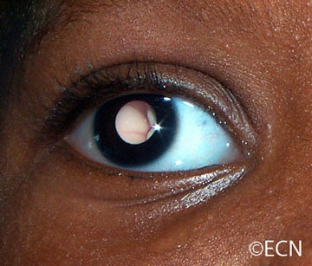
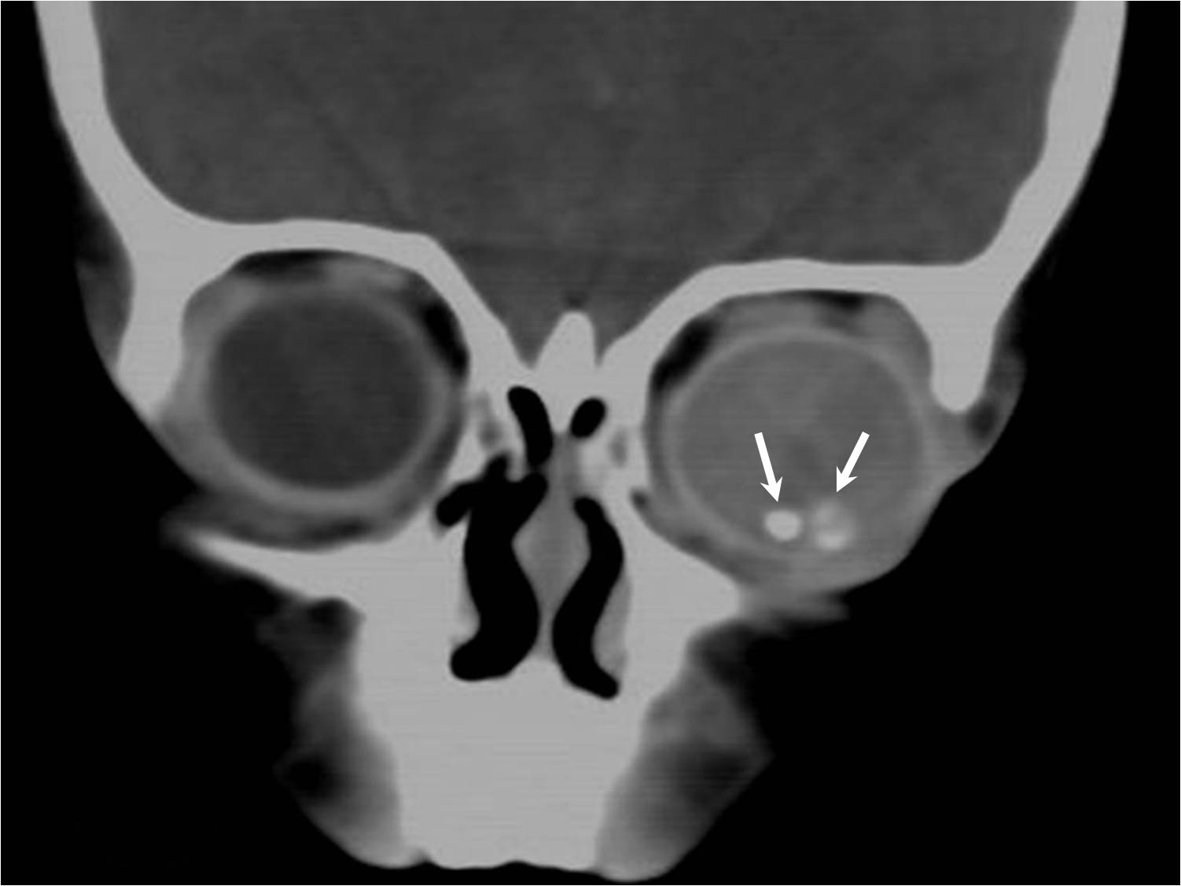
2 year old child
White opacity(leucocoria) in both eyes since birth
Poor vision since birth
Protrusion , watering and redness since 15 days

Slide 36
RETINOBLASTOMA

Slide 37
CAUSES OF LEUCOCORIA
Retinoblastoma
Congenital cataract
Coloboma of choroid
ROP – retrolental fibroplasia
Persistent Hyperplastic Primary hyperplasia
Toxocara endophthalmitis
Exudative retinopathy of coats

Slide 38
OBJECTIVES
INTRODUCTION
GENETICS – KNUDSON’S HYPOTHESIS
HISTOPATHOLOGY
CLINICAL FEATURES
DIAGNOSIS
TREATMENT

Slide 39
INTRODUCTION
Congenital
Detected between 1 – 2 yrs
Neurosensory Retina
1 in 20,000 live births
Mostly U/L (25-30% B/L)

Slide 40
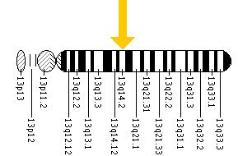
GENETICS
Long arm of Ch. 13q14
Knudson’s two hit hypothesis
Hereditary
Non Hereditary - U/L
40 % of all cases
Autosomal Dominant
Multifocal
If B/L 40% chances in sibling

Slide 41
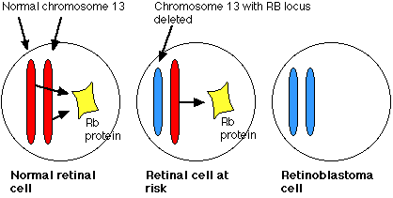

Slide 42
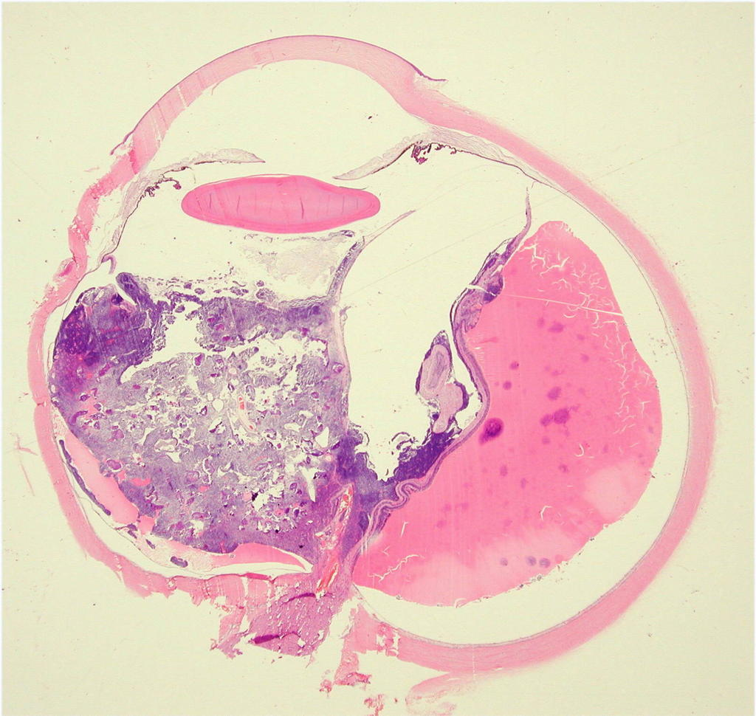
PATHOLOGY
Proliferation of immature retinal neural cells
Small round cells with large nuclei

Slide 43
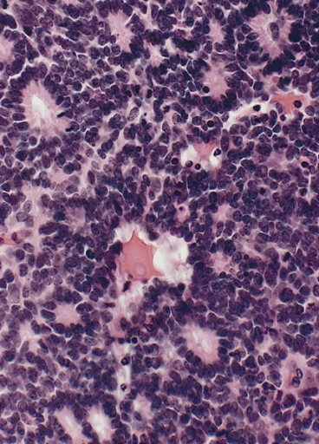
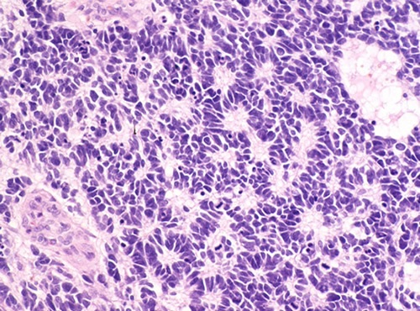
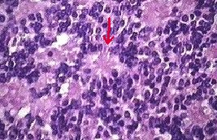
HISTOPATHOLOGY
Flexner-wintersteiner rosettes
Homer wright rosettes
Fleurettes

Slide 44
CLINICAL FEATURES
4 Stages
Quiescent stage
Galucomatous stage
Stage of extraocular extension
Stage of distant metastasis

Slide 45
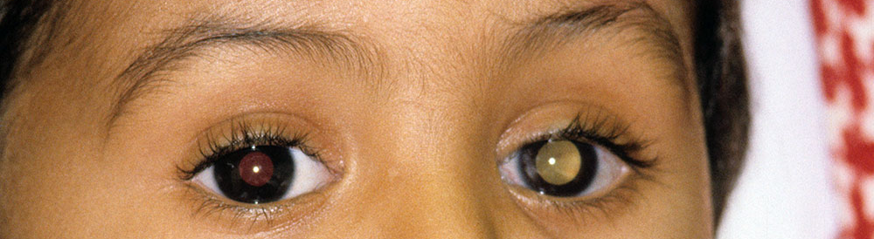
QUIESCENT STAGE
6 mts to 1 year
Leucocoria / Amaurotic Cat’s eye
Squint
Nystagmus
Defective vision – rare
Ophthalmoscopy – Exophytic and Endophytic growth

Slide 46
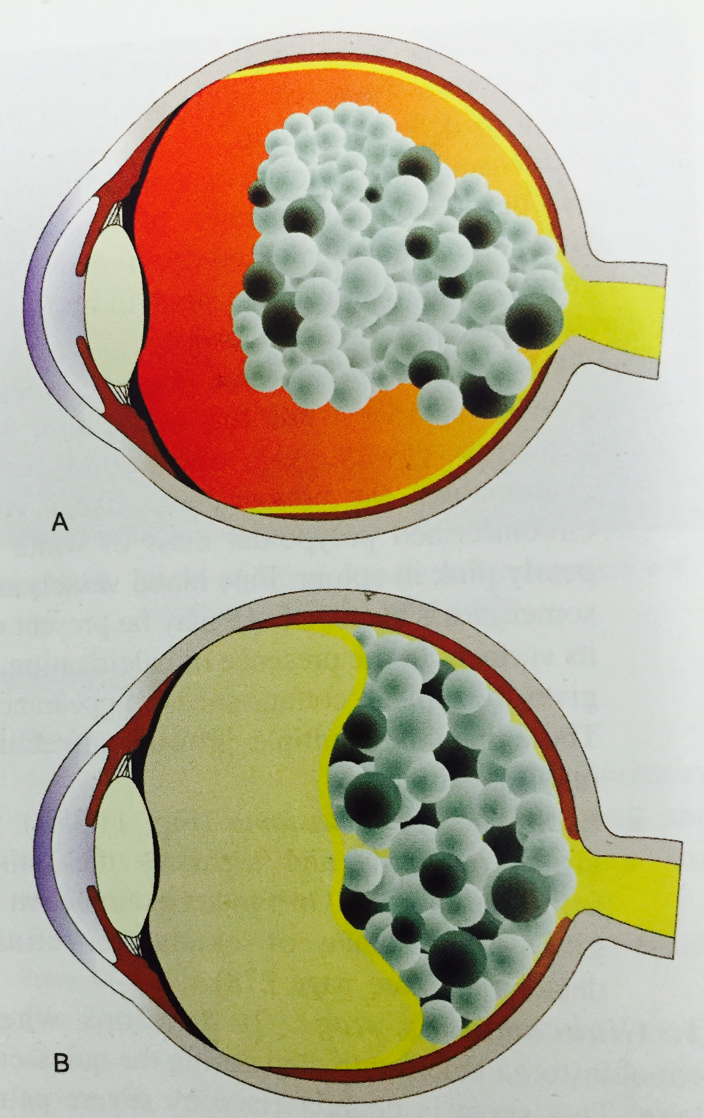
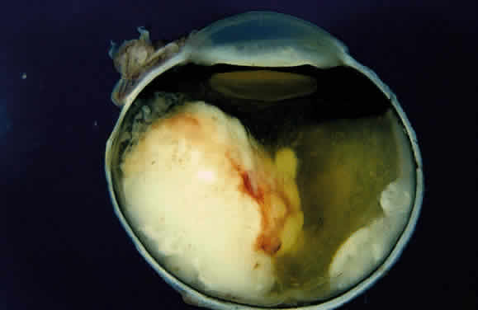
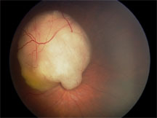
ENDOPHYTIC
EXOPHYTIC

Slide 47
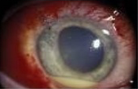
GLAUCOMATOUS STAGE
Severe eye pain
Redness
Watering
Proptosis
Congestion
Hazy Cornea
Raised IOP
Pseudohypopyon / Hyphaema

Slide 48
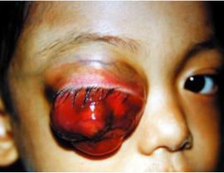
EXTRAOCULAR EXTENSION
Globe bursts through sclera
Involvement of extraocular tissue
Marked proptosis

Slide 49
DISTANT METASTASIS
Lymphatic spread
Direct extension
Blood stream

Slide 50
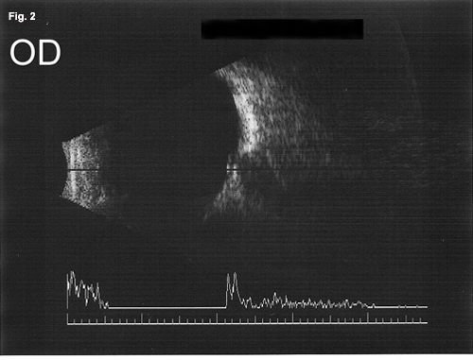
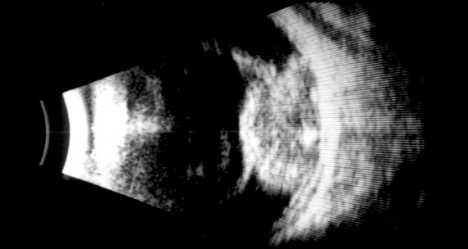
DIAGNOSIS
IOP measurement
Corneal Diameter
Fundus Exam
B-Scan
NORMAL

Slide 51
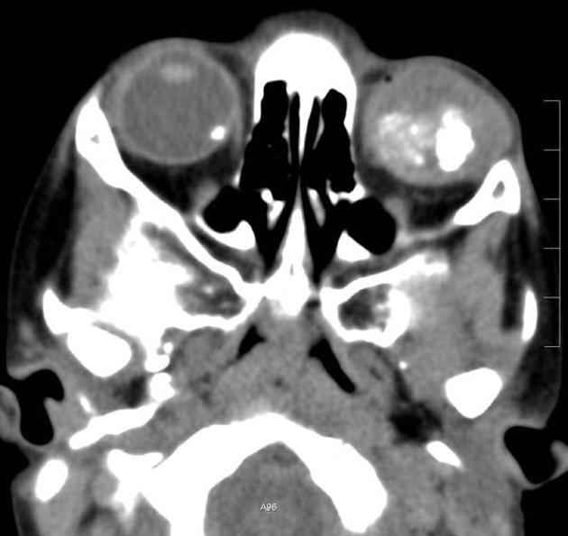
DIAGNOSIS
LDH level in aqueous humor
Plain X-ray
CT

Slide 52
TREATMENT
1) TUMOR DESTRUCTIVE THERAPY
Chemoreduction
Radiotherapy – EBRT / BRACHY
Cryotherapy
Laser Photocoagulation
Thermotherapy

Slide 53
TREATMENT
2) ENUCLEATION
Tumor > ½ retina
Optic nerve involved
Glaucoma present
Anterior chamber involvement
If optic nerve invasion – radio + chemo

Slide 54
TREATMENT
3) PALLIATIVE THERAPY
With Orbital extension
With Intracranial extension
With distant metastasis
CHEMO + EBRT + SURGICAL DEBULKING(EXENTRATION)

Slide 55
PROGNOSIS
Survival rate 70-85% - enucleation before extraocular
extension
Poor – optic nerve involvement
Undifferentiated tumor cells
Massive choridal invasion

Slide 56
THANK YOU

